Slide 1
Comp 4350 Software Engineering II Lecture 10
Dr. Shaowei Wang

Slide 2
Administrative items
Technical seminar (the week of Oct 31)
The purpose of the seminar is to share knowledge and experience among teams. The topic of the seminar could be technology, design choice, challenges you faced and how you solved them, and lessons have learned, etc.
The seminar should be 15 mins (~13 minutes for presentation, 2 mins for Q&A ) for each team.
The presentation will be evaluated in three aspects:
1) usefulness of the seminar
2) quality of the presentation
Each team will be evaluated by other teams and the instructor (the weight is 70% : 30%), in terms of the usefulness of the seminar and presentation quality.
Schedule could be found in the google sheet
https://docs.google.com/spreadsheets/d/1ewp5bUNU8EbpPAQqRLjMIKLyGNiLejSgUvC55txSoIA/edit#gid=0
Submit your slides to UMLearn -> Assignments -> Technical seminar

Slide 3

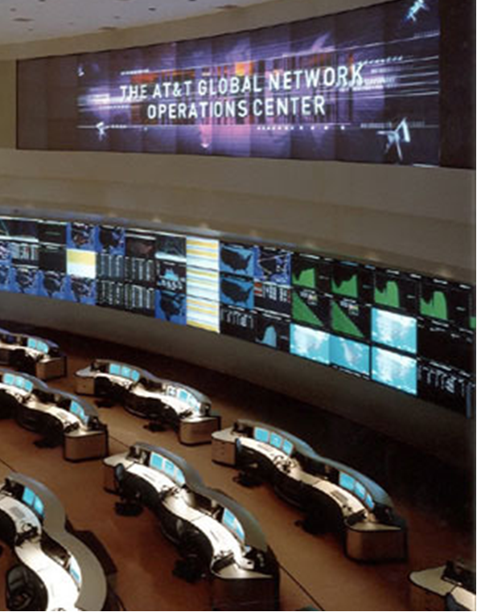


(Ultra) Large-Scale Software Systems
4 million users 2600-3000 req/sec on most weekdays
450 million active users > 50 billion messages every day
Notes:
http://highscalability.com/blog/2014/2/26/the-whatsapp-architecture-facebook-bought-for-19-billion.html
http://highscalability.com/blog/2010/12/31/facebook-in-20-minutes-27m-photos-102m-comments-46m-messages.html
http://highscalability.com/blog/2015/1/12/the-stunning-scale-of-aws-and-what-it-means-for-the-future-o.html
http://highscalability.com/blog/2014/7/21/stackoverflow-update-560m-pageviews-a-month-25-servers-and-i.html
Note that 2600-3000 req/sec for stackoverflow is the peak rate on most work days
http://highscalability.com/blog/2012/2/13/tumblr-architecture-15-billion-page-views-a-month-and-harder.html
Need to mention “Enterprise systems” used by hundreds or thousands of users

Slide 4
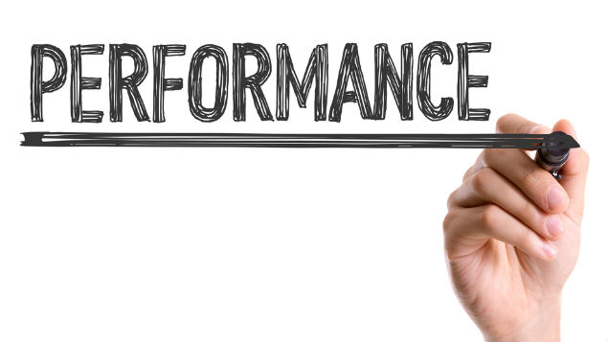

Software system failures are often due to performance issues rather than functional bugs
Loading
Notes:
Performance is an important aspect of software quality.
Prior study has reported that Software system failures are often due to performance issues rather than functional bugs.
Performance are often measured by high level measurement, such as response time of the system and physical level measurements such as CPU, memory and I/O

Slide 5
A page load slowdown of only one second could cost?
$1.6 billion
Notes:
"Such regressions may also have financial impacts. Page load slowdown is one of the typical examples of performance regression. A report by Amazon shows that a one second page slow down may cause 1.6 billion loss of revenue."

Slide 6
The short-battery-life of the Surface Pro tablet was due to a software performance bug

Slide 7
Outline
Software Performance Engineering (SPE)
Performance testing
Load testing

Slide 8
Software Performance Engineering (SPE)

Slide 9
Performance Efficiency (ISO 25010)
Quality (sub) factor | Description
Performance efficiency | Performance relative to the amount of resources used under stated conditions
Time behavior | Degree to which the response and processing times and throughput rates of a product or system, when performing its functions, meet requirements
Resource utilization | Degree to which the amounts and types of resources used by a product or system when performing its functions meet requirements
Capacity | Degree to which the maximum limits of a product or system parameter meet requirements

Slide 10
Software performance
Performance measures the efficiency of the software against the constraints of time and resource allocation.
There are several indicators to capture and evaluate performance.
Response Time: The total elapsed time between submission of a request and receipt of the response.
Processing Rate/Throughput: The total completions per unit time, e.g. Transactions/Sec.
Utilization: The ratio of busy time to total time (how busy or free the resources within a given system are).
Other indicators (e.g., capacity, battery/power consumption)
It is possible to consider the performance of
entire system (including hardware and software)
part of the system such as a software component.

Slide 11
Software Performance Engineering (SPE)
The set of tasks or activities that need to be performed across the Software Development Life Cycle (SDLC) to meet the documented Performance Requirements.

Slide 12
SPE: Objectives
Increase revenue by ensuring the system processes all transactions in a timely manner.
Eliminate delayed deployment due to performance issues.
Reduce the increased costs of maintenance due to performance issues during production or ad hoc performance corrections.
Reduce operational overhead to address system problems due to performance issues.
Identify bottlenecks by simulating a prototype.
Increase server capacity.

Slide 13
Software Development Life Cycle
Performance Engineering Life Cycle
Functional Requirements Gathering
Non-functional Requirements Gathering
Architecture & Design
Design for High Performance
Implementation
Unit Performance Test & Code Optimization
System Test & User Acceptance Test
Performance Test
Deploy Into Production
Monitoring & Capacity Management
Source: https://tangowhisky37.github.io/PracticalPerformanceAnalyst/pages/
spe_fundamentals/performance_engineering_101/
Notes:
Requirements Gathering – Document Non Functional Requirements and get client & team buy in. The Performance Requirements Analysis section will delve deeper into details.
Architecture & Design – Design & Architect for high performance. Use various modelling techniques to validate the design assumptions from both an application design and infrastructure design standpoint.
Build – Implement coding standards. Work with the development leads to implement guidelines focussed on validating and reporting unit performance for all the code being written.
Test – Document your Performance Testing Strategy and validate the application for the documented Non Functional Requirements. Evolve your Performance Monitoring & Capacity Management strategy as you move through SVT.
Production – Monitor your application and model the Application Performance with the objective of Identifying Infrastructure Capacity impacts. Call out the need to optimize the application / database to meet Non Functional Requirements or provision additional infrastructure to meet growing business workload.

Slide 14
Software Development Life Cycle
Performance Engineering Life Cycle
Functional Requirements Gathering
Non-functional Requirements Gathering
Architecture & Design
Design for High Performance
Implementation
Unit Performance Test & Code Optimization
System Test & User Acceptance Test
Performance Test
Deploy Into Production
Monitoring & Capacity Management
Notes:
Requirements Gathering – Document Non Functional Requirements and get client & team buy in. The Performance Requirements Analysis section will delve deeper into details.

Slide 15
SPE: Requirements Phase
Review production performance metrics of the current version if available.
Determine non-functional requirements.
So that system performance goals can be set and measured against.
Identify tools, resources and infrastructure.
Early identification allows budget and time allocation for installation and staff training.

Slide 16
Software Development Life Cycle
Performance Engineering Life Cycle
Functional Requirements Gathering
Non-functional Requirements Gathering
Architecture & Design
Design for High Performance
Implementation
Unit Performance Test & Code Optimization
System Test & User Acceptance Test
Performance Test
Deploy Into Production
Monitoring & Capacity Management
Notes:
Architecture & Design – Design & Architect for high performance. Use various modelling techniques to validate the design assumptions from both an application design and infrastructure design standpoint.

Slide 17
SPE: Architecture and Design
Evaluate the alternatives.
Provide input from a performance perspective to the architecture being recommended.
Determine the capacity of the required infrastructure.
By combining the non-functional requirements with the architecture design, determine the underlying infrastructure requirements (e.g., CPU, RAM, GPU).
Define performance targets for developers.
Define performance targets for the development teams across application components in case any bottleneck happens.

Slide 18
Key considerations for designing software
Optimize algorithms: Choose algorithms that are efficient and optimize them to minimize the amount of processing required.
Use parallel processing: Parallel processing can help improve performance by distributing processing across multiple cores or processors.
Consider scalability: The architecture should be designed with scalability in mind. As the amount of data processed increases, the system should be able to handle the load without a significant decrease in performance.
Use caching and load balancing: Caching can help reduce the amount of processing required by storing frequently accessed data in memory. Load balancing can help distribute the workload across multiple servers to improve performance.

Slide 19
Software Development Life Cycle
Performance Engineering Life Cycle
Functional Requirements Gathering
Non-functional Requirements Gathering
Architecture & Design
Design for High Performance
Implementation
Unit Performance Test & Code Optimization
System Test & User Acceptance Test
Performance Test
Deploy Into Production
Monitoring & Capacity Management
Notes:
Test – Document your Performance Testing Strategy and validate the application for the documented Non Functional Requirements. Evolve your Performance Monitoring & Capacity Management strategy as you move through SVT.

Slide 20
SPE: Testing
Create performance tests to simulate the workload model.
Use the tests to validate the non-functional requirements.
Identify application bottlenecks.
Validate the impact of code and configuration changes on application performance.
Identify performance regressions

Slide 21


What is a performance regression?
Old version
New version
Does the new version have worse performance than the old version?
Notes:
So what is a performance regression? As software evolves, the performance of the same feature under the same workload may change.
For example, here we have two versions of the system, we examine the performance of the two versions and ask does the new version have worse performance than the old version? If so, then there exists performance regression.
Such regressions may compromise the user experience, increase the operating cost of the system, and cause field failures.

Slide 22
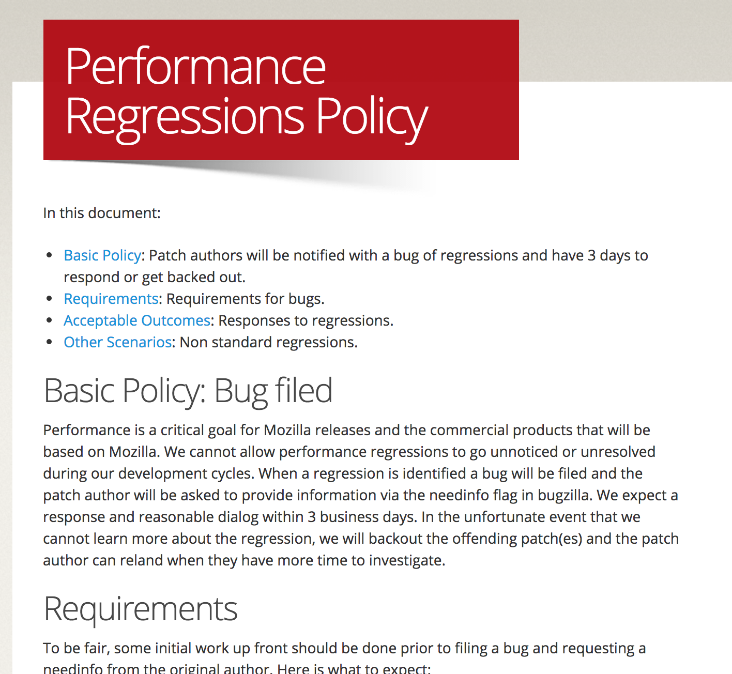
Mozilla takes performance regression seriously!

Slide 23
Software Development Life Cycle
Performance Engineering Life Cycle
Functional Requirements Gathering
Non-functional Requirements Gathering
Architecture & Design
Design for High Performance
Implementation
Unit Performance Test & Code Optimization
System Test & User Acceptance Test
Performance Test
Deploy Into Production
Monitoring & Capacity Management
Notes:
Test – Document your Performance Testing Strategy and validate the application for the documented Non Functional Requirements. Evolve your Performance Monitoring & Capacity Management strategy as you move through SVT.

Slide 24
SPE: Monitoring & Capacity Management
Perform performance monitoring to continuously assess software performance, and to identify when the system is reaching its capacity.
Perform capacity management to provide the required infrastructure capacity to sustain growth in business workloads.
Provide production workload data to support the development of the next version.

Slide 25
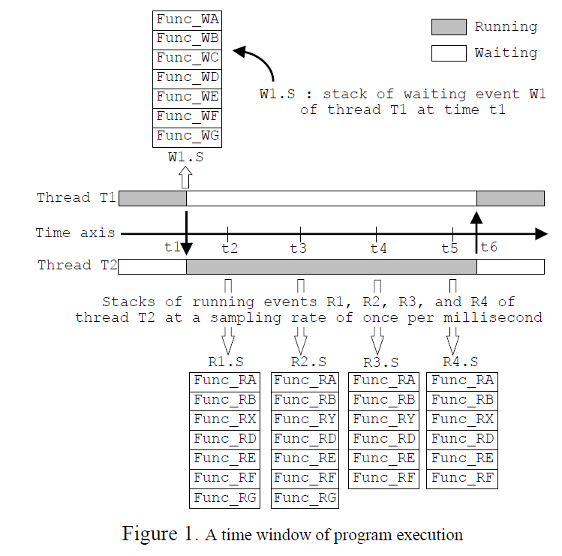
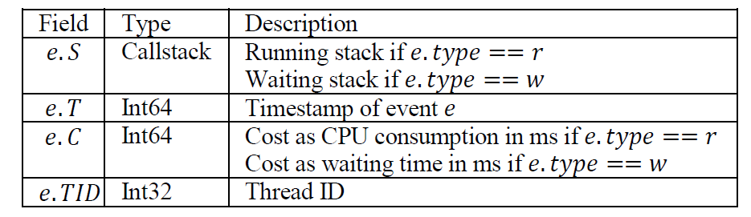
How the form it as a pattern mining problem?
Transaction data
Callstack
pattern
If a callstack pattern is observed from many trace streams that cost large amount of CPU, it is suspicious to be a highly impactful performance bug
Notes:
They modify the definition of support to include cost of event info, but it still follow the aprior property.

Slide 26
Benefits of SPE
Defining a clear set of non-functional requirements ensures successful development.
The constant and early focus on system performance during all phases of development prevents late and costly changes in the future.
By successfully delivering a functional and performing system as required, the customer will receive full value.
Notes:
Find problem as early as possible. Don’t only rely on performance testing for the performance requirements of your system only.

Slide 27
Performance Testing

Slide 28
Performance Testing
All the tests and methodologies to measure, verify and validate the performance of the system.
It is part of SPE.
Its objectives include:
Demonstrate system compliance with performance criteria.
Measure and identify the components that cause the system to not perform well.

Slide 29
Testing: Types of tests
Stress testing: Tests the limits of the system's capacity (beyond max load).
Endurance testing: Tests the system under the expected load for a long time.
Spike testing: Tests the reaction of the system by suddenly increasing or decreasing the load generated by a very large number of users
Capacity testing: Tests the system to find the maximum capacity.
Configuration testing: Test the effect of various configuration or configuration changes to the system.
Load testing: Tests the performance of the system under the expected load.
A number of users who perform a specified number of requests during a given period of time.

Slide 30
Stress testing
Stress testing emphasizes on robustness, availability and error handling under a heavy load rather than on what is correct behavior under normal situations.
Particularly important for critical software but is used for all types of software.

Slide 31
Characteristics of stress testing
Stress testing analyzes the behavior of the system after a failure.
Stress testing makes sure that the system recovers after failure.
It ensures to display appropriate error message when the system is under stress.
Metrics: Time to failure, error rates, behavior under failure conditions, and recovery time

Slide 32
Testing: Types of tests
Stress testing: Tests the limits of the system's capacity (beyond max load).
Endurance testing: Tests the system under the expected load for a long time.
Spike testing: Tests the reaction of the system by suddenly increasing or decreasing the load generated by a very large number of users
Capacity testing: Tests the system to find the maximum capacity.
Configuration testing: Test the effect of various configuration or configuration changes to the system.
Load testing: Tests the performance of the system under the expected load.
A number of users who perform a specified number of requests during a given period of time.

Slide 33
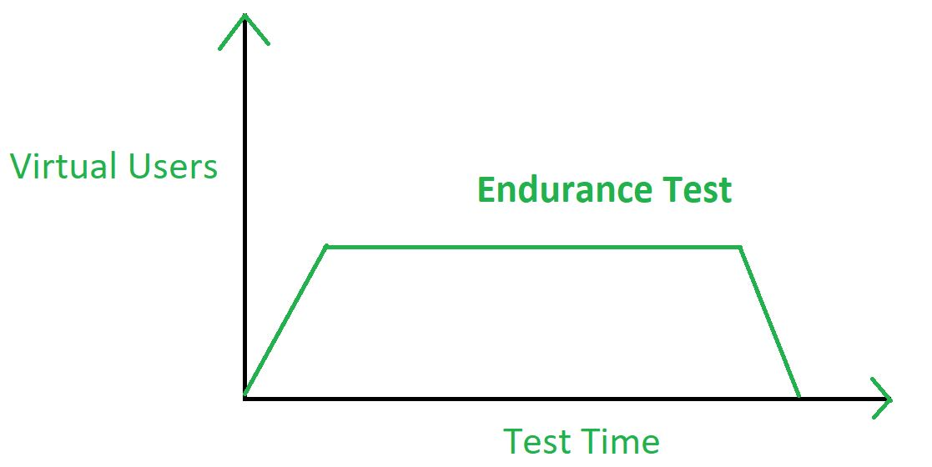
Endurance testing
Endurance Testing is performed to observe whether an application can resist the processing load it is expected to have to endure for a long period (months or a year).
Endurance testing includes the testing of the operating system and the computer hardware up to or above their maximum loads for a long period of time.

Slide 34
Endurance testing
It helps in identification of performance problems occurs when system is used for a long period of time.
Memory consumption is considered to determine potential failures
Metrics: Memory consumption, response time consistency, error rates over extended periods, resource leaks.

Slide 35
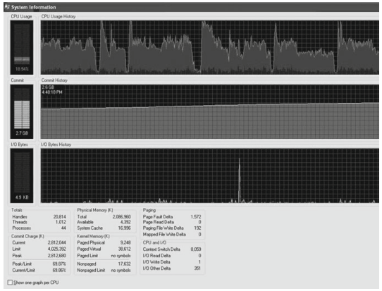
Looking for known patterns: Deadlocks and memory leak
CPU
Memory
Performance data under steady load
[Avritzer et al., 2012]
Notes:
- The drops in CPU usage indicate that a deadlock repeatedly occurred, followed by a release on timeout. An investigation of the code showed that this was indeed
the case. The problem was remedied, and troughs went away on a subsequent run.
- The constant increase in memory usage indicates the presence of a memory leak. The cause of the leak was identified and eliminated.
This example illustrates how the analysis of performance measurements was used to identify and eliminate two potential causes of system instability. The repeated
deadlocks resulted in intervals in which no useful work was being done. Any transactions in progress or triggered during those intervals would have had very large
response times. In production, the memory leak would have resulted in a system crash or else necessitated the stopping and restarting of the system to prevent it, had
it been allowed to continue long enough.
In Fig. 15.2, we see measurements of the same use case after the problems encountered were remedied. The CPU utilization oscillates within a very small range
rather than dropping down to zero from time to time as in Fig. 15.1. Also, the number of committed bytes stays fairly constant throughout the run rather than increasing
once the initial rampup period is over.

Slide 36
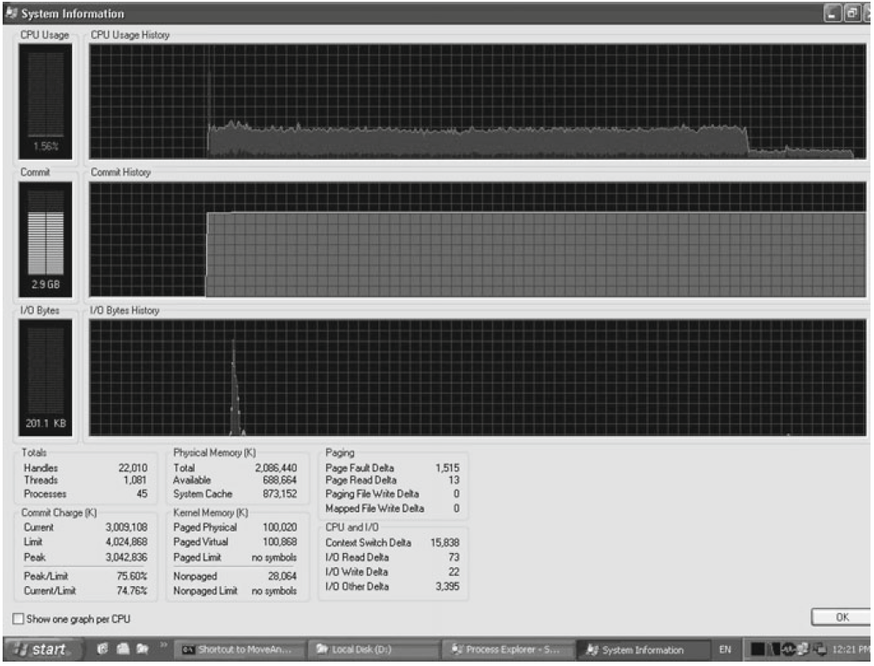
Deadlocks and memory leak: before and after fix
Before fix
After fix
[Avritzer et al., 2012]
Notes:
Figure 15.1 shows measurements of a system under constant load. The processor usage drops off from time to time, and then resumes its normal usage after showing a
spike of activity following the dropoff. Memory usage increases at a rate that appears to be nearly constant. The spike in I/O activity may be attributable to logging.
- The drops in CPU usage indicate that a deadlock repeatedly occurred, followed by a release on timeout. An investigation of the code showed that this was indeed
the case. The problem was remedied, and troughs went away on a subsequent run.
- The constant increase in memory usage indicates the presence of a memory leak. The cause of the leak was identified and eliminated.
This example illustrates how the analysis of performance measurements was used to identify and eliminate two potential causes of system instability. The repeated
deadlocks resulted in intervals in which no useful work was being done. Any transactions in progress or triggered during those intervals would have had very large
response times. In production, the memory leak would have resulted in a system crash or else necessitated the stopping and restarting of the system to prevent it, had
it been allowed to continue long enough.
In Fig. 15.2, we see measurements of the same use case after the problems encountered were remedied. The CPU utilization oscillates within a very small range
rather than dropping down to zero from time to time as in Fig. 15.1. Also, the number of committed bytes stays fairly constant throughout the run rather than increasing
once the initial rampup period is over.

Slide 37
Testing: Types of tests
Stress testing: Tests the limits of the system's capacity (beyond max load).
Endurance testing: Tests the system under the expected load for a long time.
Spike testing: Tests the reaction of the system by suddenly increasing or decreasing the load generated by a very large number of users
Capacity testing: Tests the system to find the maximum capacity.
Configuration testing: Test the effect of various configuration or configuration changes to the system.
Load testing: Tests the performance of the system under the specific load.
A number of users who perform a specified number of requests during a given period of time.

Slide 38
Load Testing
Objective: To determine how the system behaves under expected load scenarios. It checks the system's performance by applying the anticipated load in terms of users or tasks it can handle within defined performance criteria (e.g., 1000 requests/second).
Metrics: Response time, throughput, transaction rates, and server resource utilization under anticipated load conditions.

Slide 39
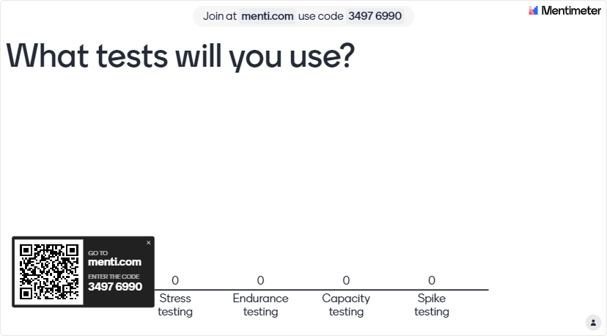
Question: you have online gaming server, you would like to validate server stability and performance in a long period of time (over a couple weeks) understand a stable number of players. What tests will you use?

Slide 40
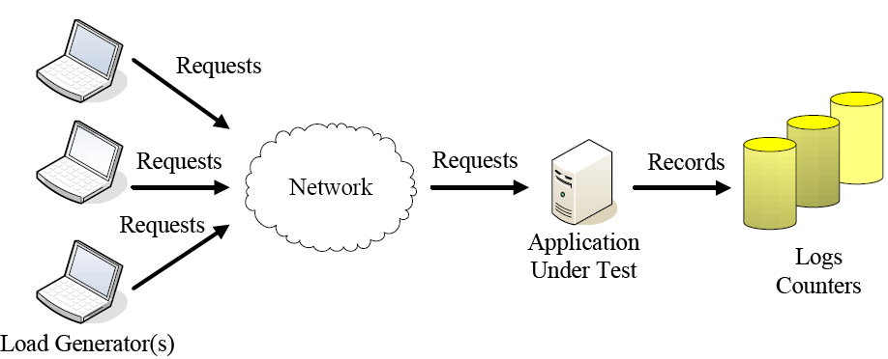
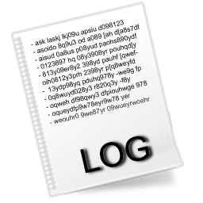

Load Testing
Test Design
Test Execution
Test Analysis
Mimics multiple users repeatedly performing the same tasks
Take hours or even days
Produces GB/TB of data that must be analyzed
Notes:
Load testing in general assess the system behavior under load to detect load-related problems.
This figure illustrates a typical setup of a load test …

Slide 41
How can we design loads?
Load Testing Objectives
Designing load Tests
Testing Load
Designing Performance Tests
Designing Realistic Loads | Designing Fault-Inducing Loads
Load Design Optimizations and Reductions
Executing Load Tests
Loading Test Data
Analyzing Data
Test report

Slide 42
Designing Realistic Loads
Design loads, which resemble the expected usage once the system is operational in the field.
Notes:
If you have a system , the load requirement is 1000 request/second, then you use requirement to design test

Slide 43

Characterizing an Aggregate Workload
Workload Mix (ratio of different types of requests)
browsing (30%), purchasing (10%) and searching (60%)
Workload Intensity
Rate of requests (e.g., 100 requests/sec)
Notes:
When design a workload, we need to consider to things, the portion of each load and the intensity of the load

Slide 44
Designing Realistic Loads
An E-Commerce System
Aggregate Workload
Use-Case
100%
Login 10% (10,000)
Browse 80% (80,000)
Purchase 5% (5,000)
Logout 5% (5,000)
Login
Browse
Purchase
Logout
Notes:
The aggregate-workload based load design approach aims to generate the individual target request rates. For example, an e-commerce system is expected to handle three types of requests with different transaction rates: ten thousand purchasing requests per second, three million browsing requests per second, and five hundred registration requests per second. The resulting load, using the aggregate-workload based load design approach, should resemble these transaction rates.
generating requests that are derived from realistic use cases

Slide 45
How can we get the workload mix (ratio) of user action?

Slide 46
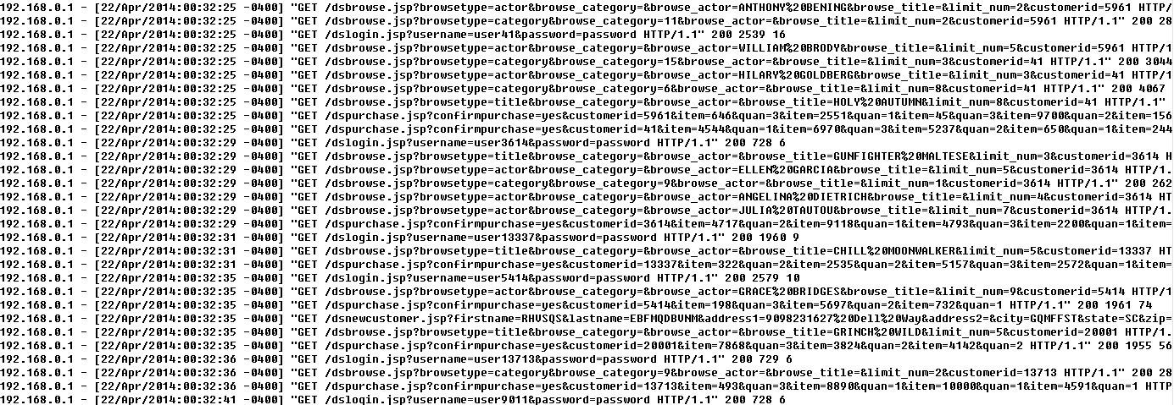
Estimate using historical data
web access logs for the past few months
Notes:
Apache access logs, will be used later in the demo and the assignments

Slide 47
Estimate using historical data
192.168.0.1 - [22/Apr/2014:00:32:25 -0400] "GET /dsbrowse.jsp?browsetype=title&browse_category=&browse_actor=&browse_title=HOLY%20AUTUMN&limit_num=8&customerid=41 HTTP/1.1" 200 4073 10
192.168.0.1 - [22/Apr/2014:00:32:25 -0400] "GET /dspurchase.jsp?confirmpurchase=yes&customerid=5961&item=646&quan=3&item=2551&quan=1&item=45&quan=3&item=9700&quan=2&item=1566&quan=3&item=4509&quan=3&item=5940&quan=2 HTTP/1.1" 200 3049 177
192.168.0.1 - [22/Apr/2014:00:32:25 -0400] "GET /dspurchase.jsp?confirmpurchase=yes&customerid=41&item=4544&quan=1&item=6970&quan=3&item=5237&quan=2&item=650&quan=1&item=2449&quan=1 HTTP/1.1" 200 2515 113
For customer 41: browse -> purchase

Slide 48
Estimate the probability/intensity based on logging
User 1: log -> search -> purchase
User 2: log -> browse -> browse -> purchase
User 3: log -> search -> browse -> purchase
…
log -> search (40/100)
Log-> browse (60/100)
Search->browse (3/60)
Search 0-> purchase (57/60)
…

Slide 49
Estimate using historical data
0.05
Search
Purchase
…
0.4
Login
0.95
0.15
0.6
Browse
0.05
…
0.8

Slide 50
For new project
Set equivalent load for each action
Refine the load as you get some historical data

Slide 51
Aggregate Workload - Workload Intensity
Steady Load
Ease of measurement
Memory leaks?
Step-wise Load
Same workload mix
Different workload intensity
User increase in step-wise?
[Bondi, CMG 2007]
[Hayes, CMG 2000]
https://support.smartbear.com/loadcomplete/docs/testing-with/configuring/load-test-editor/ramp-up.html
Notes:
Steady load for measurements and for detecting things like memory leaks
Conduct a perfmon demo to show the CPU and memory usage

Slide 52




Realistic load tests are based on (historical) field workloads, but field workloads change over time
Keep updating the realistic load tests
Notes:
Load testing workloads (or load test cases) are typically based on historical field workloads. However, field workload are continuously changing. One example is # of user increases.

Slide 53
How can we design loads?
Load Testing Objectives
Designing load Tests
Testing Load
Designing Performance Tests
Designing Realistic Loads | Designing Fault-Inducing Loads
Load Design Optimizations and Reductions
Executing Load Tests
Loading Test Data
Analyzing Data
Test report

Slide 54
Designing Fault-Inducing Loads
Design loads, which are likely to cause functional or non-functional problems under load.
Identify potential load sensitive modules and regions for load sensitive faults (e.g., memory leaks and incorrect dynamic memory allocation
Annotating the Control Flow Graph of malloc() / free() calls and their sizes
Write test cases which exercise the code regions with high LSI values
[Yang el al., ISSTA 1996]
Notes:
e.g., Certain functions are more likely to cause performance issues, like memory allocation, sync function.

Slide 55
Performance Test Process
Performance Test Objectives
Designing Performance Tests
Testing Load
Executing Performance Tests
Live-user Based Execution | Driver Based Execution
Setup
Load Generation and Termination
Test Monitoring and Data Collection
Executing Performance Tests
Performance Test Data
Analyzing Performance Data
Performance Test report

Slide 56


Live-user Based Test Execution
Reflects realistic user behavior
Obtain real user feedbacks on acceptable performance and functional correctness
Hard to scale (e.g., limited testing time)
Limited test complexity due to manual coordination
Coordinated live-user testing
Users are selected based on different testing criteria (e.g., locations, browser types, etc.)
Notes:
Live user can say this image is a bit off to the right (or smaller than expect). But the other two approaches cannot. uTest: https://www.utest.com

Slide 57


Driver-based Test Execution
Easy to automate
Scale to large number of requests
Hard to track some system behavior (e.g., audio quality or image display)
No real user feedback
Use existing tools to coordinate the testing
Notes:
For Peer-to-peer, there could be a central agent which coordinates among the load as well (Master/Salve style)

Slide 58

Test monitoring and data collection
Test Monitoring and Data Collection
Metrics and Logs

Slide 59
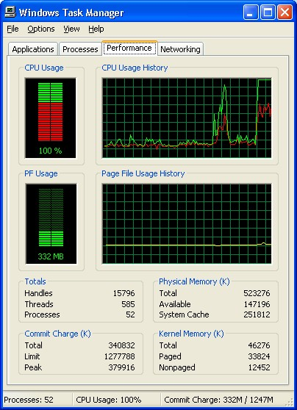
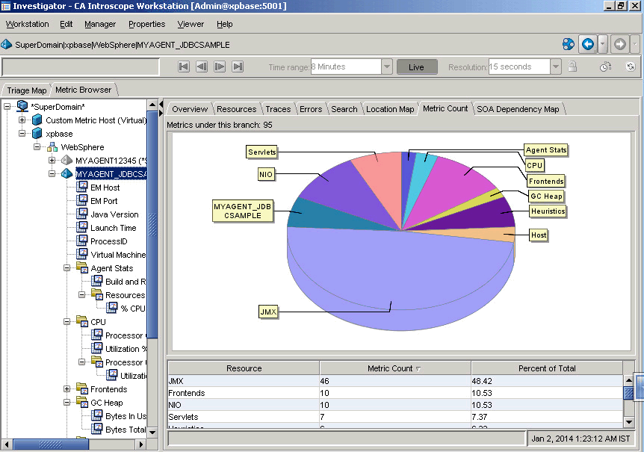
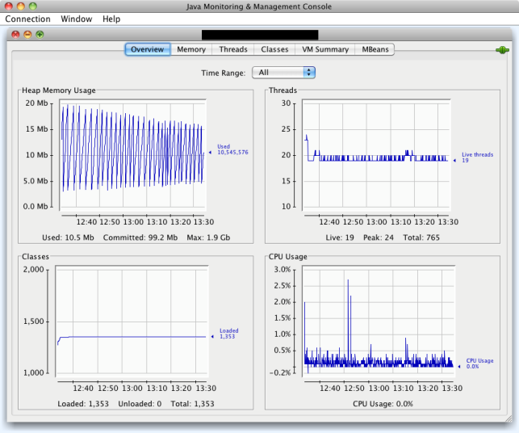
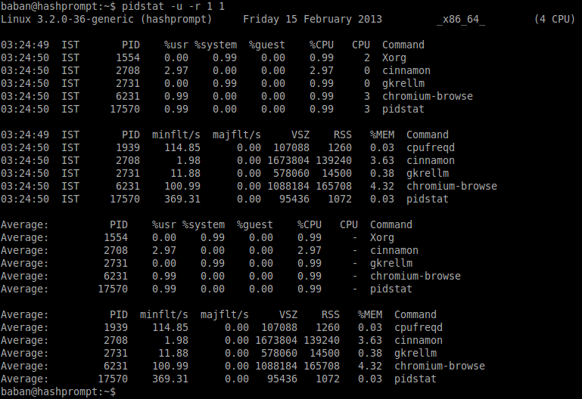
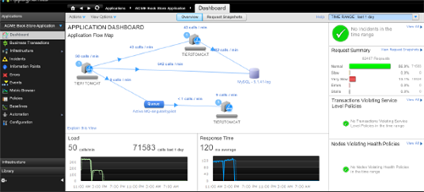
Test Monitoring Tools
CA Willy
JConsole
Task Manager
App Dynamics
pidstat

Slide 60
Performance Test Process
Performance Test Objectives
Designing Performance Tests
Analyzing Performance Data
Verifying Against Threshold Values | Detecting Known Problems | Building Performance Models
Testing Load
Executing Performance Tests
Performance Test Data
Analyzing Performance Data
Performance Test report

Slide 61
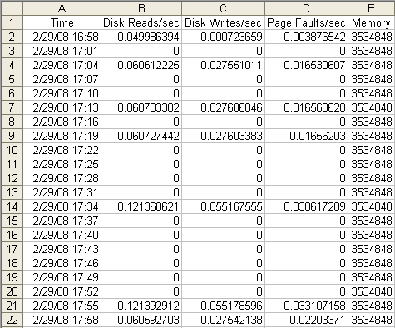
Sample Counters
Notes:
Typically a timer series like data (periodically sampling data: can be a snapshot, can be an average, or can aggregate [e.g. total number of packets received])
They are usually resource usage or system level metrics (e.g., # of input/output requests).
Lots of counters and follows different trend over time

Slide 62
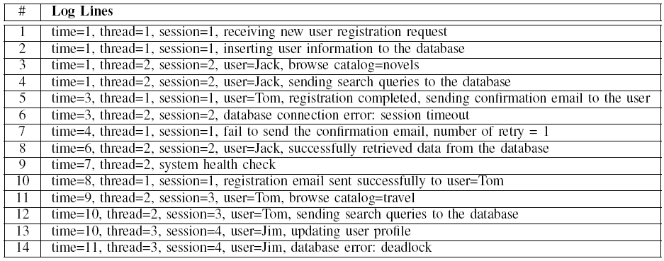
Sample Execution Logs
Notes:
Output statements that developers insert into the code.
1. Mention that it’s per line
2. Mention it contains the business level process steps and background activities (e.g. periodic health checks), and errors
3. Contains rich information about system behavior but it’s free formed data

Slide 63
Verifying Against Threshold Values
Version 1
Version 2
Threshold from requirement
Threshold from a prior version

Slide 64

Detecting Known Problems Using Patterns
Patterns in the memory utilizations
Memory leak detection
Patterns in the logs
Error keywords

Slide 65
Looking for known patterns: Deadlocks and memory leak
CPU
Memory
Performance data under steady load
[Avritzer et al., 2012]
Notes:
- The drops in CPU usage indicate that a deadlock repeatedly occurred, followed by a release on timeout. An investigation of the code showed that this was indeed
the case. The problem was remedied, and troughs went away on a subsequent run.
- The constant increase in memory usage indicates the presence of a memory leak. The cause of the leak was identified and eliminated.
This example illustrates how the analysis of performance measurements was used to identify and eliminate two potential causes of system instability. The repeated
deadlocks resulted in intervals in which no useful work was being done. Any transactions in progress or triggered during those intervals would have had very large
response times. In production, the memory leak would have resulted in a system crash or else necessitated the stopping and restarting of the system to prevent it, had
it been allowed to continue long enough.
In Fig. 15.2, we see measurements of the same use case after the problems encountered were remedied. The CPU utilization oscillates within a very small range
rather than dropping down to zero from time to time as in Fig. 15.1. Also, the number of committed bytes stays fairly constant throughout the run rather than increasing
once the initial rampup period is over.

Slide 66
Looking for keywords in logs

Slide 67
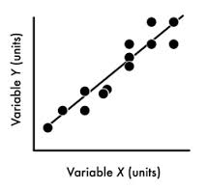
Building performance models
Machine learning
(Black box) model
Anomaly

Slide 68
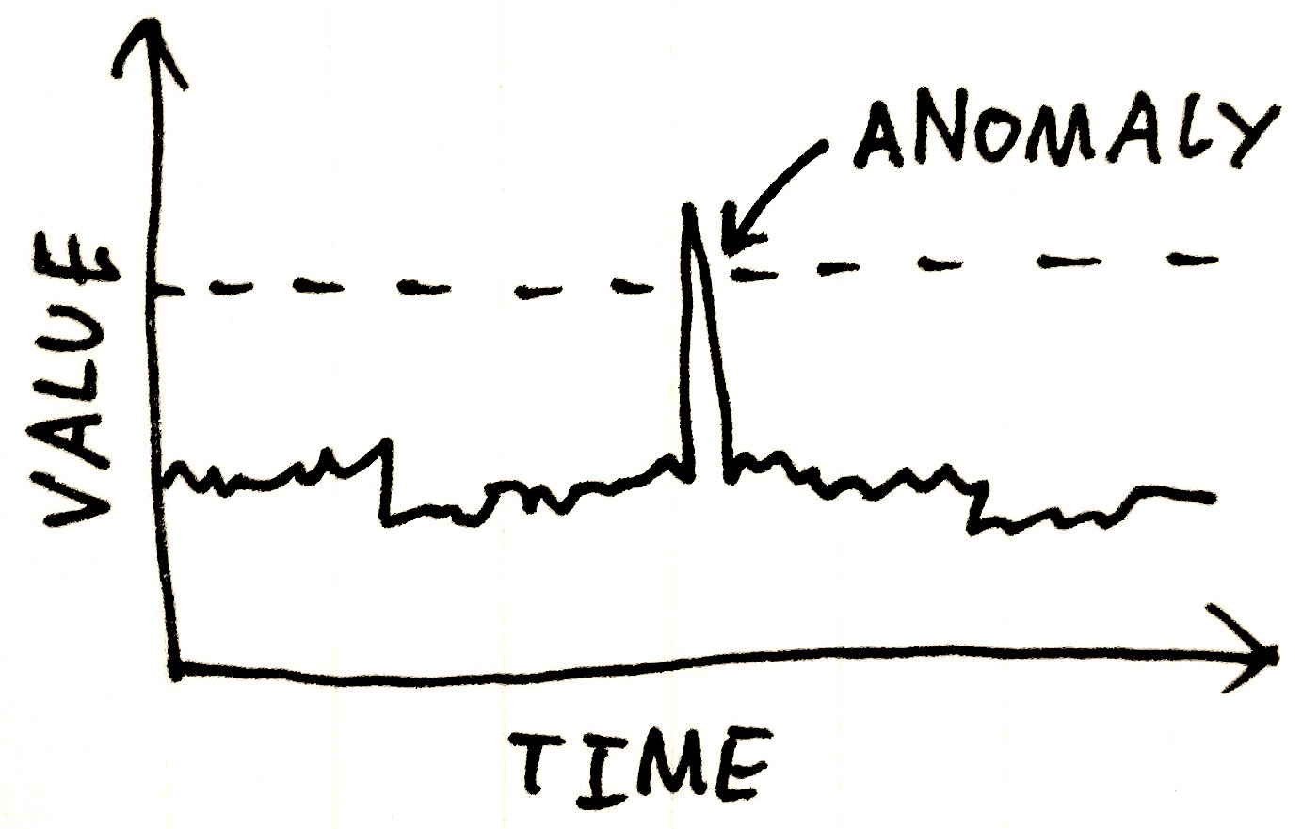
Predict using machine learning models

Slide 69
Reference
Jiang ZM. Load testing large-scale software systems. In2015 IEEE/ACM 37th IEEE International Conference on Software Engineering 2015 May 16 (Vol. 2, pp. 955-956). IEEE.
Jiang ZM, Hassan AE. A survey on load testing of large-scale software systems. IEEE Transactions on Software Engineering. 2015 Jun 15;41(11):1091-118.
https://www.geeksforgeeks.org/software-testing-endurance-testing/
https://www.geeksforgeeks.org/stress-testing-software-testing/
https://www.geeksforgeeks.org/difference-between-load-testing-and-stress-testing/?ref=lbp

Slide 70
Software performance metrics

Slide 71

Measurements: Basic concepts
Objectives:
Evaluate compliance with performance targets.
Provide input data for SPE models, to verify and validate models.
Monitor performance during the software lifecycle.
Static and dynamic measurements
Static: No need to run the system.
Dynamic: The system must be running during the measurement.
Performance measures are quite dynamic.
Internal and external measurements
Internal: Code to detect events and record performance data must be inserted into the system code.
External: The software that measures is independent of the software that is measured.

Slide 72
Measurements: Process
Understand the objective of the measurement (questions and hypothesis).
Identify the data needed to answer these questions, collection tools and measurement techniques.
Identify experimental variables and controls.
Define the test cases: workload, software component and environment for each test.
Run the tests and collect the data.
Analyze, interpret, present the results.

Slide 73
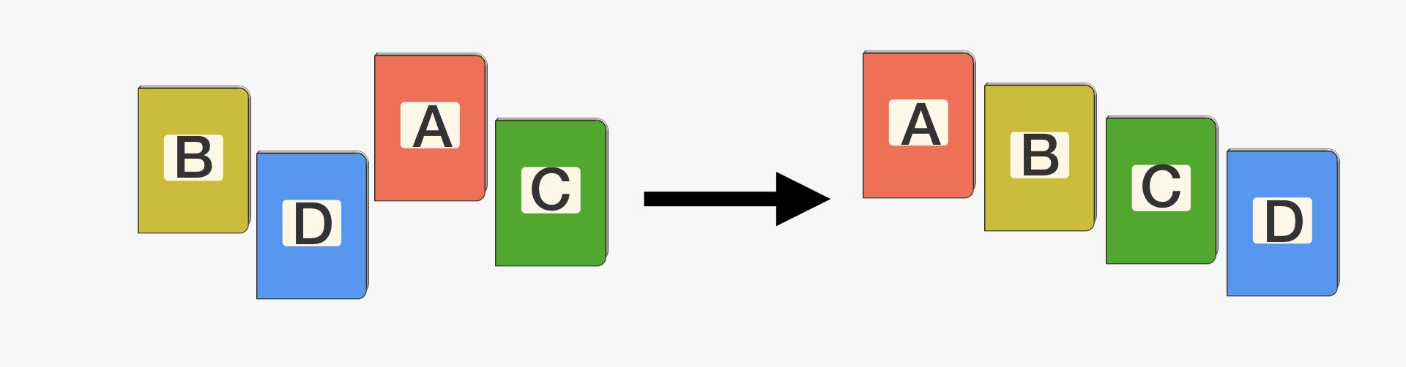
Measurements: Example - Exercise
You need to develop a system that needs a sorting functionality. You have to choose between an existing solution or to develop the functionality from scratch.
Define the plan of measurements to evaluate the two options.

Slide 74
Measurements: Sorting Component
Objective: To use a standard sorting algorithm or to develop a personalized algorithm.
Data collection:
Measure the resource requirements (CPU, disk, memory) for each algorithm.
Use a system to record events.
Evaluate the measurement overload on the performance of the measured system.
Experimental variables:
Number of items
Item size
Order of original data
The sorting algorithm
Test cases:
List length: 36, random ordered numbers
List length: 2000, random ordered numbers
List length: 8400, random ordered numbers
Run the tests: Run each test cases several times.

Slide 75
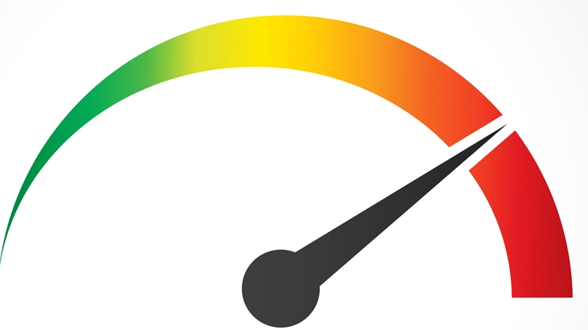
Measurements: Data Type
Workload data: number, rate and query patterns
Data characteristics: number and size of data, frequency of queries for data
Execution characteristics:
Path characteristics: number of executions for each important path, number of repetitions of loops, probability of execution of conditional paths.
Software resource usage: number of requests for each software resource, average execution time.
Processing overload: the time of processing resources (CPU, disk, memory) required by software resources.
System usage:
Response time
Throughput
Use of processing resources: processing time + waiting time
Resource utilization: percentage of busy time
Resource queue length: number of tasks waiting to be served.

Slide 76
Measurements: Bias
Measurement bias is hard to avoid and unpredictable.
Example 1: How come the same application today runs faster compared with yesterday?
Example 2: Why the response time is very different when running the same binary under different user accounts?
Example 3: Why the code optimization only works on my computer?
Repeated measurement
Randomize experiment setup
[Mytkowicz et al., ASPLOS 2010]
Notes:
Example 1: Because there are caching effects. One is the system level cache (e.g., disk) check Ahmed’s email on “Remote account” on measurement of SSD. The other one is application level cache. Other reasons can be confounding factors (e.g., when I run my tests, other processes like an anti-virus scan or system backup can be interfering)
Example 2: Why not the same performance under different user account? => Take a guess, because the memory layout could be different due to your environment variable setup or the way how the application is loaded into memory (one page or multiple pages).
Example 3: Because the link order of binaries (hence when they do compiler optimization e.g., O3 for gcc) it might work for one type of software architecture, but not the other one

Slide 77
Measurements: Challenges
System disturbance
When the measurement system affects the performance of the system being measured.
Timing of measurements
Consider the operating system clock, sampling interval
Reproducible results
The system is not isolated and other operations affect monitoring and performance.
Workload generation

Slide 78
Challenges of SPE
By promoting time to market and budget constraints, the importance of SPE in the software lifecycle is reduced.
Performance is perceived by users.
Developers know the features but they cannot perceive the performance.
Quality experts know performance, but they don't know features.
One recommended solution to bridge the gap is automation.
Eliminate the need for qualified people for manual construction of methods and models for performance.
Reduce time and effort for performance validation.

